Slide 1
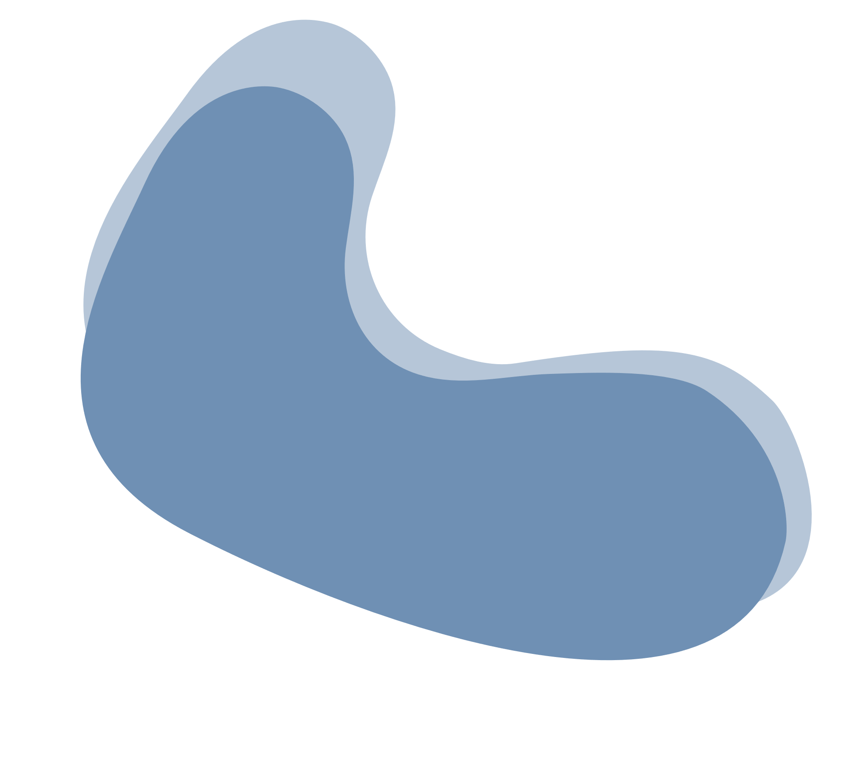
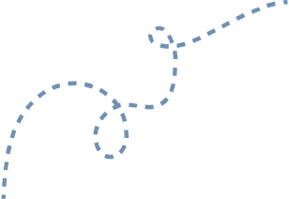
Best State-of-the-art Models For Semantic Segmentation Problems And Their Abilities And Limitations
Angelika Żyła

Slide 2
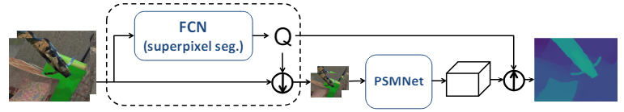
DATASET
Amos: A large-scale abdominal multi-organ benchmark for versatile medical imageFigure 1. An illustration of our superpixel-based downsampling/upsampling scheme for deep networks. In this figure, we choose PSMNet [7] for stereo matching as our task network. The high-res input images are first downsampled using the superpixel association matrix Q predicted by our superpixel segmentation network. To generate a high-res disparity map, we use the same matrix Q to upsample the low-res disparity volume predicted by PSMNet for final disparity regression [2]Creator

Slide 3
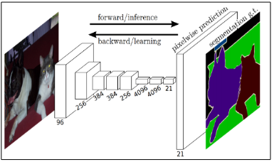
Figure 2. FCN workflow diagram (Long et al., 2015)

Slide 4
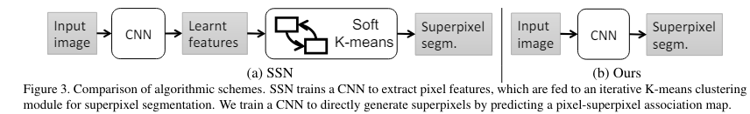
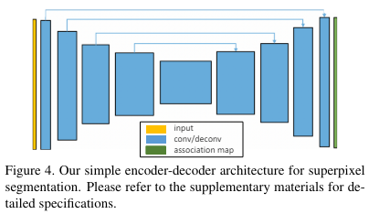

Slide 5
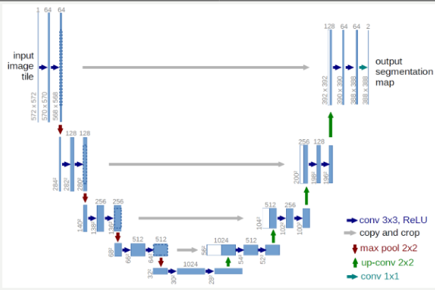
Figure 5. U-Net workflow diagram .

Slide 6
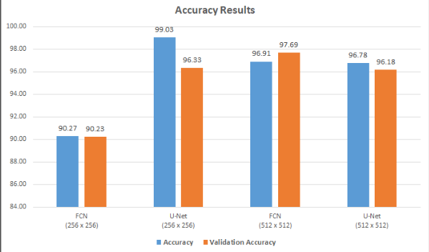
Figure 6. Training and validation accuracy results of the models.
Figure 7. Training and validation loss results of the models.

Slide 7
AdaEn-Net: Self-Adaptive 2D–3D FCN for 3D Medical Image Segmentation
Problem - Manual design of Fully Convolutional Networks (FCNs) for segmentation is time-consuming and can lead to large, complex architectures. Many automatic design approaches fail to fully utilize volumetric information or optimize model size.
Solution - AdaEn-Net, a self-adaptive ensemble of 2D and 3D FCNs, is proposed to address these issues by integrating volumetric data and optimizing performance and size for specific datasets [1].

Slide 8
Automatically finds optimal architectures and hyperparameters to maximize segmentation accuracy and minimize model parameters.
PROMISE12 Grand Challenge (Prostate Segmentation)
Ranked 9th out of 297 submissions, Outperformed an automatically-generated segmentation network with 13% fewer parameters.
MICCAI ACDC Challenge (Cardiac Segmentation)
Ranked within the top 8 submissions, Outperformed a reinforcement learning-designed architecture with 1.25% fewer parameters.

Slide 9
SUMMARY
The datasets and rules used to create training data should be carefully analyzed.
The U-Net architecture produced significantly more accurate results than FCN using a 256 x 256 dataset.
FCN performed better, but not significantly higher, than U-Net when trained on the 512 x 512 dataset.
These differences were also visible in the predicted segmentation results.
An ensemble of adaptive 2D-3D FCNs for medical image segmentation that optimizes model performance and size.
2D FCN - Extracts long-range 2D feature relationships.
3D FCN - Analyzes information inside slices.
A multi-objective evolutionary algorithm to automatically construct 2D FCN and 3D FCN architectures for a given segmentation task by minimizing expected errors.

Slide 10
BIBLIOGRAPHY
[1] Maria Baldeon Calisto, Susana K. Lai-Yuen, „AdaEn-Net: An ensemble of adaptive 2D–3D Fully Convolutional Networks for medical image segmentation”, Neural Networks, Volume 126, 2020, Pages 76-94, ISSN 0893-6080, https://doi.org/10.1016/j.neunet.2020.03.007.
[2] Ozan OZTURK., Batuhan SARITURK, Dursun Zafer ŞEKER, Comparison of Fully Convolutional Networks (FCN) and U-Net for Road Segmentation from High Resolution Imageries, Editorial Committee (December 2020).
[3] Fengting Yang Qian Sun, Hailin Jin, Zihan Zhou „Superpixel Segmentation with Fully Convolutional Networks”.
Zhang, K., Liu, D., 2023. Customized segment anything model for medical image segmentation. arXiv preprint arXiv:2304.13785 .
[4] Yanwei Li, Hengshuang Zhao, Xiaojuan Qi, Liwei Wang, Zeming Li, Jian Sun, Jiaya Jia;, „Fully Convolutional Networks for Panoptic Segmentation”, Proceedings of the IEEE/CVF Conference on Computer Vision and Pattern Recognition (CVPR), 2021, pp. 214-223.

Slide 11
BIBLIOGRAPHY
[5] Radhakrishna Achanta, Appu Shaji, Kevin Smith, Aurelien ´ Lucchi, Pascal Fua, and Sabine Susstrunk. SLIC superpix- ¨ els compared to state-of-the-art superpixel methods. IEEE Trans. Pattern Anal. Mach. Intell., 34(11):2274–2282, 2012. 1, 2, 3, 4, 5
[6] Radhakrishna Achanta and Sabine Susstrunk. Superpix- ¨ els and polygons using simple non-iterative clustering. In CVPR, pages 4895–4904, 2017. 1, 2, 3, 5
[7] Pablo Arbelaez, Michael Maire, Charless Fowlkes, and Jitendra Malik. Contour detection and hierarchical image segmentation. IEEE Trans. Pattern Anal. Mach. Intell., 33(5):898–916, 2010. 2, 5
[8] Stan Birchfield and Carlo Tomasi. Multiway cut for stereo and motion with slanted surfaces. In ICCV, pages 489–495, 1999. 3

Slide 12
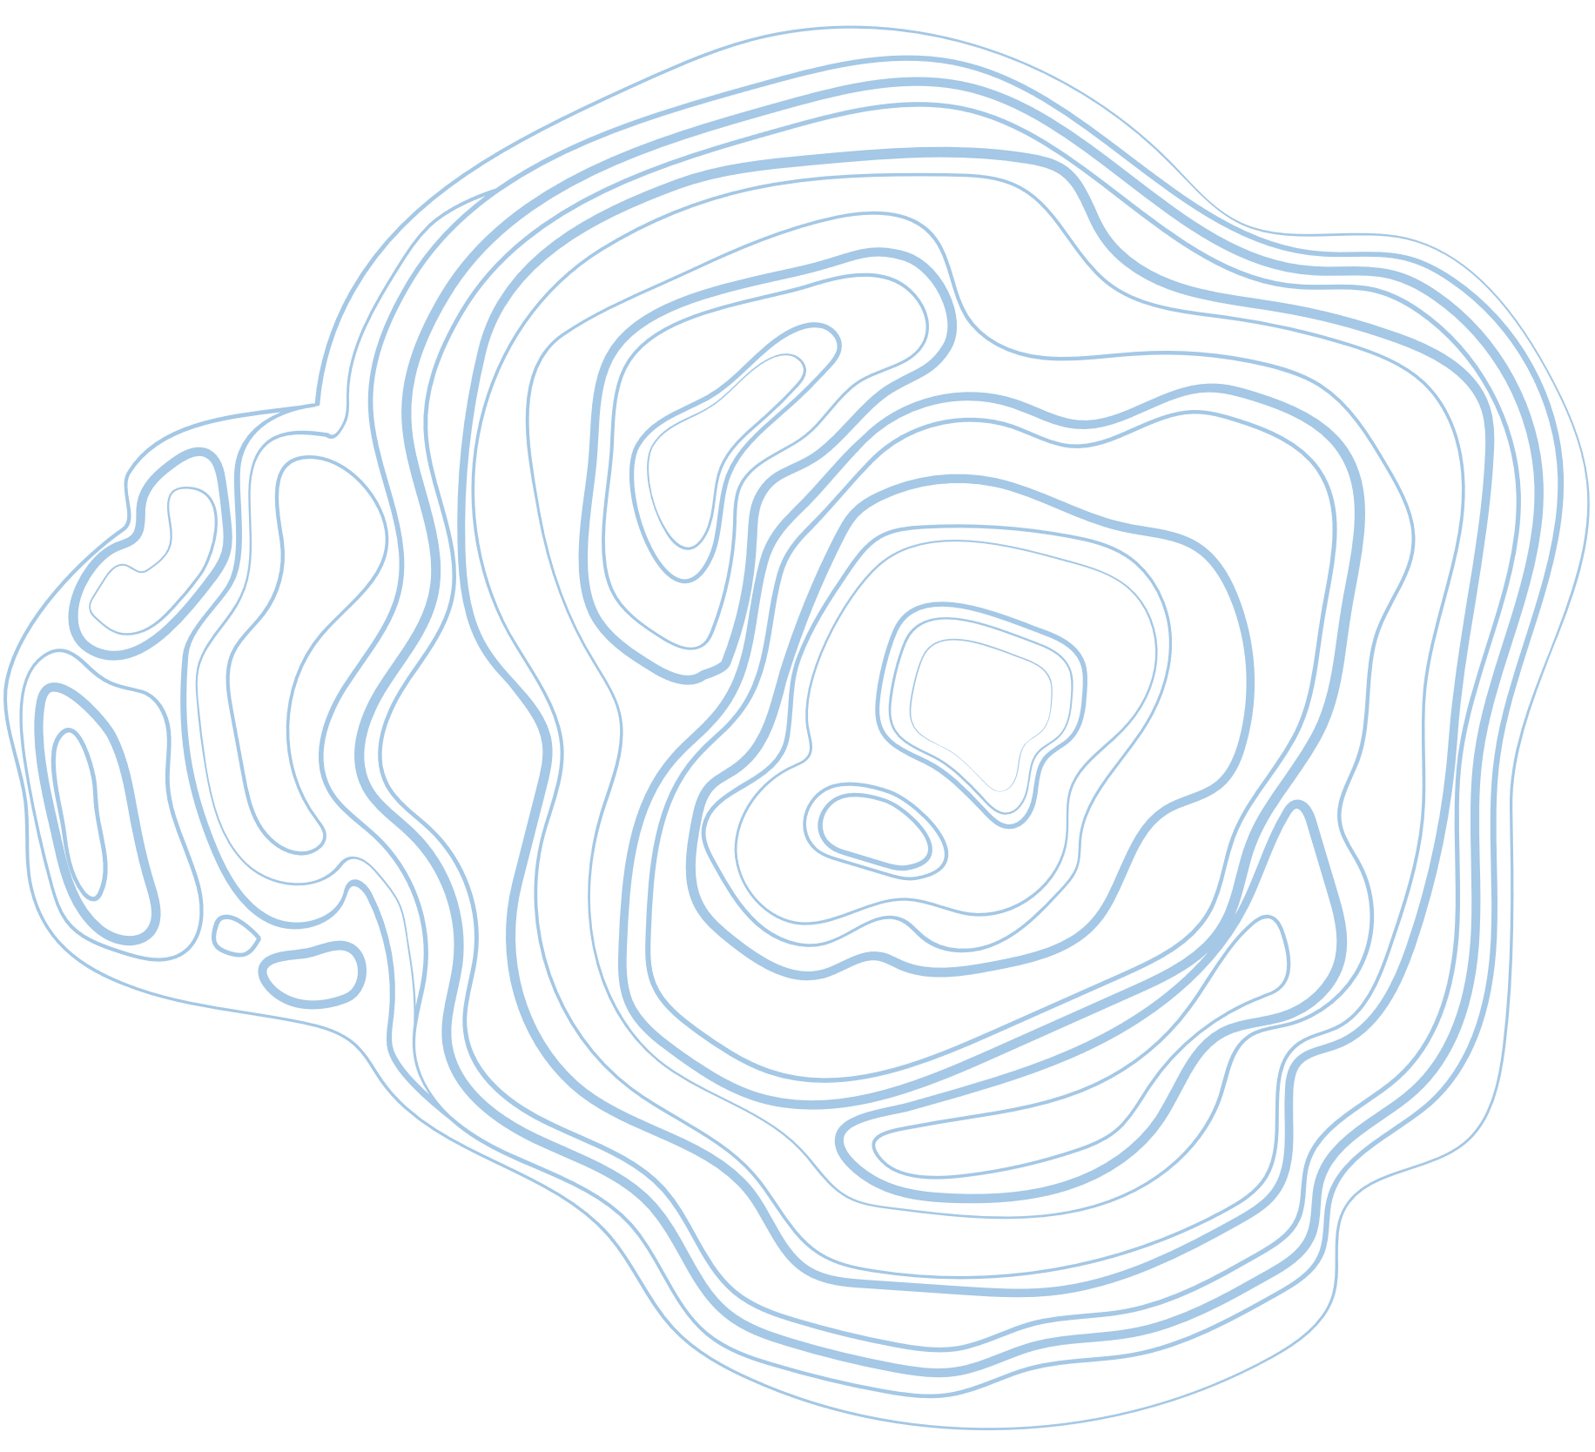





Thank You

